Slide 1

Marketing Planning Assistant Agent
Low-Level Design Presentation

Slide 2

Project Introduction
The Marketing Planning Assistant Agent is an AI-driven application that helps users design structured marketing strategies through an interactive chat interface.It converts high-level goals into actionable plans using LLM-based reasoning, task decomposition, and workflow optimization.
The system integrates research capabilities, web scraping, and SQLite-based memory to deliver context-aware recommendations. This approach reduces manual planning effort, improves decision quality, and accelerates marketing execution.The project highlights core agentic AI concepts such as autonomous planning, tool integration, and adaptive response generation.

Slide 3
Key Capabilities Demonstrated
Autonomous Decomposition
Resource Validation
Dependency Management
Dynamic Optimisation
Breaks high-level goals into granular tasks automatically.
Verifies availability of data, APIs, and resources.
Identifies task dependencies for optimal execution.
Adapts task sequences in real-time to changing conditions.

Slide 4

Problem Statement
Marketing struggles to translate strategy into executable plans efficiently. Manual planning is slow, error-prone, and ignores resource limits.
Project Objectives:
1
2
3
4
Engineer Autonomous Reasoning
Validate Resources Upfront
Establish Dependency Sequencing
Generate Optimized Schedules
Develop a Planner Agent for autonomous goal decomposition and task execution.
Verify data sources, APIs, and computational resources before execution.
Identify task dependencies for optimal execution sequencing.
Generate dynamic schedules, adapting to resources and conditions.

Slide 5




System Benefits
Accelerated Planning
Optimized Resource Utilization
Dependency Resolution
Scalable Intelligence
Reduces planning time from hours to minutes. Achieves this through automated task decomposition and scheduling.
Automatically identifies and sequences tasks. This eliminates execution conflicts for smoother operations.
Adapts to complex marketing objectives. Maintains high execution quality and reliability.
Validates resource availability upfront, preventing failures. Maximizes infrastructure efficiency.

Slide 6

System Overview
This diagram outlines the Marketing Planning Assistant Agent's core process: from strategic objectives, through autonomous planning, to actionable execution plans. It ensures alignment with overall marketing goals.
Autonomous Planning & Optimization
Strategic Objectives
Actionable Plans

Slide 7
System Components
01
02
03
Goal Ingestion Module
Reasoning Engine
Resource Validator
Ingests and parses marketing goals.
Decomposes goals into actionable tasks.
Verifies availability of data sources and resources.
04
05
Dependency Resolver
Schedule Generator
Analyzes task relationships and identifies prerequisites.
Generates execution schedules with timing and resources.

Slide 8
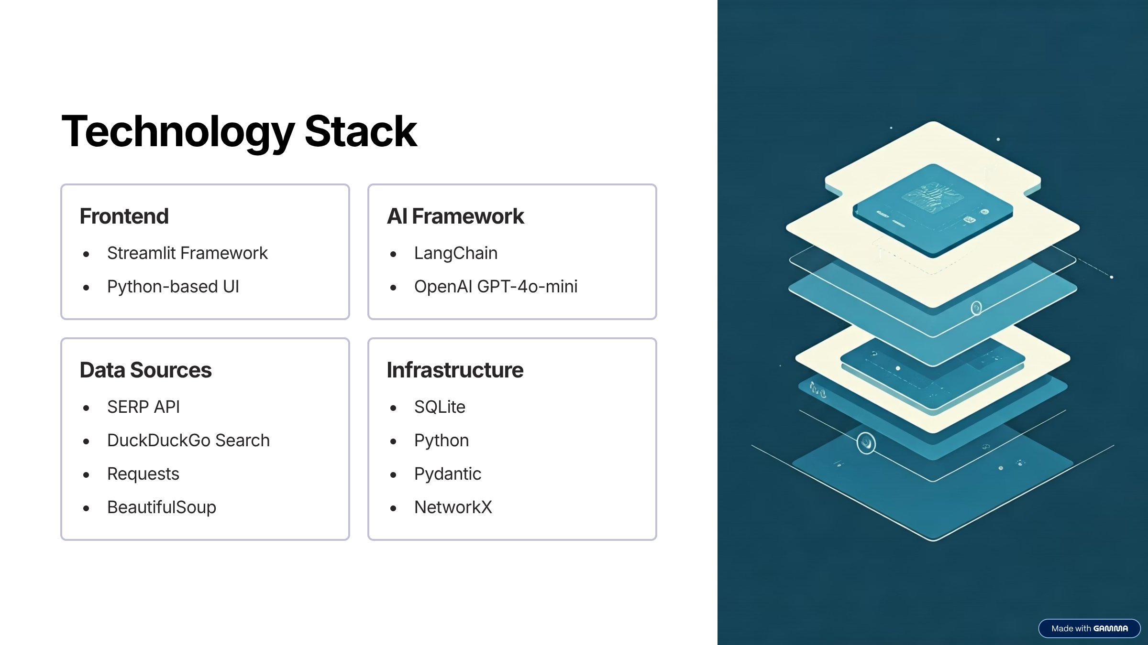

Slide 9
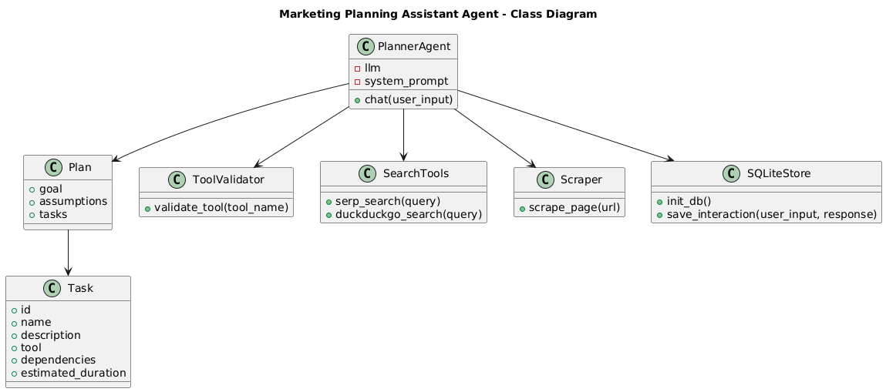
Class Diagram

Slide 10
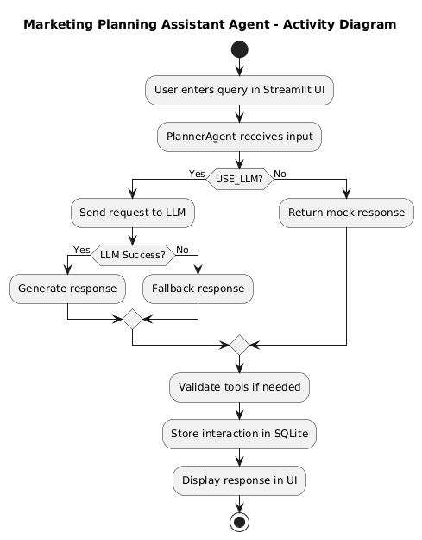
Activity Diagram

Slide 11
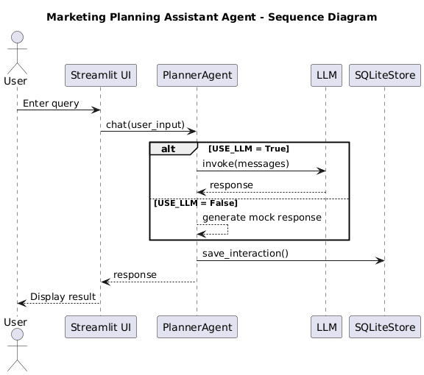
Sequence Diagram

Slide 12
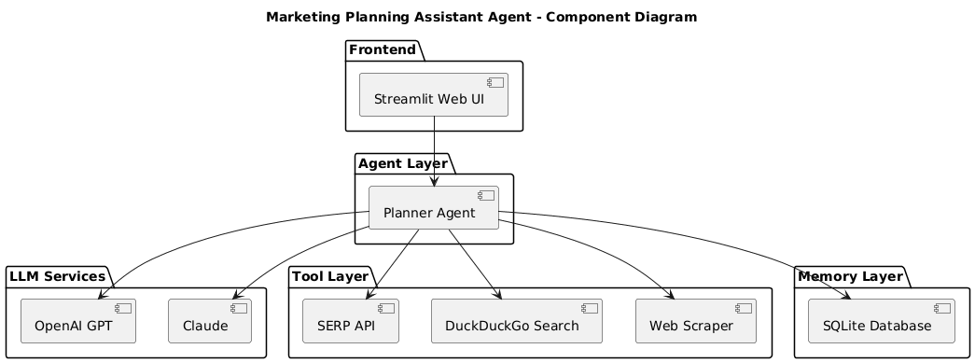
Component Diagram

Slide 13
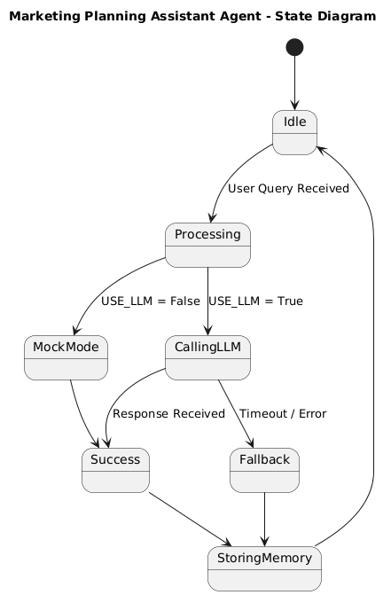
State Diagram

Slide 14
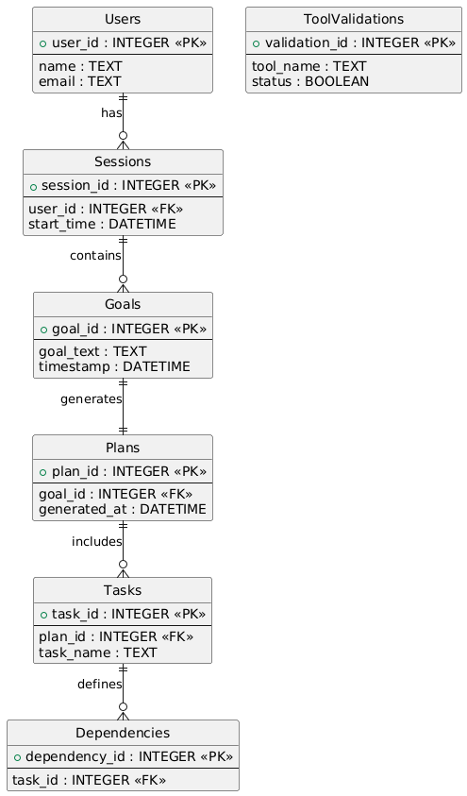
Database Design & ER Diagram
Our system's data model uses interconnected entities for marketing plan generation.
Core Entities and Attributes
Users: user_id, name, email
Sessions: session_id, user_id, start_time
Goals: goal_id, goal_text, timestamp
Plans: plan_id, goal_id, generated_at
Tasks: task_id, plan_id, task_name
Dependencies: dependency_id, task_id
Tool Validations: validation_id, tool_name, status
Key Relationships
User → Sessions
Session → Goals
Goal → Plan
Plan → Tasks
Task → Dependencies

Slide 15




Agent Roles and Responsibilities
The Marketing Planning Assistant Agent system comprises specialized agents, each critical to the autonomous planning process.
Orchestrator Agent
Resource Agent
Manages the entire planning process, from goal setting to scheduling.
Verifies availability of tools, APIs, and data sources for tasks.
Dependency Agent
Scheduler Agent
Maps inter-task relationships and optimizes execution order.
Generates time-bound schedules based on resources and dependencies.

Slide 16





Error Handling & Edge Case Management
Robust mechanisms ensure system stability and reliability, even in unforeseen circumstances, maintaining continuous operation.
Input Validation
Resource Fallback
Dependency Resolution
Pre-processes and verifies user inputs and goals, ensuring data integrity and preventing invalid operations.
Implements alternative strategies or notifies users if critical resources or tools are unavailable.
Detects and resolves circular dependencies or conflicts in task sequencing, preventing deadlocks.
Retries & Rollbacks
Alerting & Logging
Automatically retries failed tasks or initiates graceful rollbacks to maintain system consistency.
Provides real-time alerts for critical failures and detailed logs for post-mortem analysis and debugging.

Slide 17




Future Enhancements and Roadmap
Our strategic roadmap focuses on evolving the system's capabilities to deliver even more intelligent, adaptive, and integrated marketing planning solutions across different time horizons.
Short-Term Enhancements
Long-Term Vision
Refine user interface for intuitive goal definition and real-time plan visualisation, improving user adoption and experience.
Develop capabilities for fully autonomous campaign management, including adaptive strategy adjustment and self-optimisation based on real-time data.
Medium-Term Enhancements
Core Technology Upgrades
Integrate deeper analytics for campaign performance, ROI tracking, and predictive insights into market shifts and consumer behaviour.
Upgrade underlying LLM models and agent architecture, ensuring robust scalability, enhanced processing efficiency, and data security.

Slide 18



Conclusion: Empowering Your Marketing Future
The Marketing Planning Assistant Agent delivers a robust solution designed to transform your marketing operations and drive strategic success.
Enhanced Efficiency & Automation
Intelligent Strategy & Adaptation
Adaptive Growth & Reliability
Benefit from a system that continuously monitors performance, adapts to market changes, and ensures operational stability with robust error handling.
Streamline marketing operations, reduce manual effort, and accelerate plan execution for tangible time and cost savings.
Leverage AI-driven insights to craft data-informed strategies, optimise resource allocation, and achieve superior campaign outcomes.
We are committed to continuous innovation, ensuring this platform remains at the forefront of marketing technology.

